Slide 1


Linux Clusters Institute: HPC Storage: Part 2
J.D. Maloney | Sr. HPC Storage Engineer
National Center for Supercomputing Applications (NCSA)
malone12@illinois.edu
This document is a result of work by volunteer LCI instructors and is licensed under CC BY-NC 4.0 (https://creativecommons.org/licenses/by-nc/4.0/).

Slide 2
Target audience:
Those involved in designing, implementing, or managing HPC storage systems
Outline:
Wrap up FS Type Discussion
HPC Storage Best Practices
FS Benchmarking
Future Trends in Storage & Conclusion

Slide 3
Other Non HPC File Systems

Slide 4

Ceph
Characteristics
Open source parallel object storage from RedHat
Provides interfaces for object-level, block-level, and file-level storage
Metadata services and storage are segregated from data services and storage
Formats and handles raw block devices
System Components
ceph-mon – monitors cluster for active and failed cluster nodes
ceph-mds – stores metadata of inodes and directories
ceph-osd – object storage devices, stores the file
ceph-rqw – REST gateways to expose objects
Sources
Ceph – ceph.com
Ceph Wiki – tracker.ceph.com/projects/ceph/wiki/

Slide 5
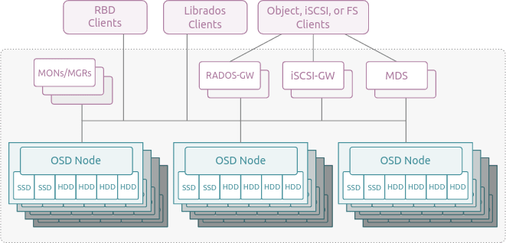
Ceph

Slide 6
Minio
Characteristics
Open source object storage product that has paid support options
Provides S3 object storage that can be scaled on commodity hardware
Lots of good object features; though NAS Gateway is deprecated
Uses XFS formatted back-end
System Components
Very simple architecture, no special server-side roles; easy to deploy
Commodity HDD/SSD based servers that are fairly uniform in configuration; referred to as “Object Storage Servers”
High speed Ethernet fabric recommended
Sources
Formal Website – https://min.io
Docs – https://min.io/docs/minio/kubernetes/upstream/

Slide 7
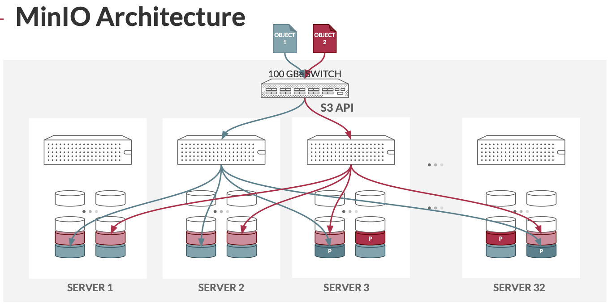
Minio

Slide 8
HPC Storage Best/Common Practices

Slide 9
General Best Practices -- FS Areas
Many HPC environments across the US/Internationally have somewhat common storage “areas” for users to use for different purposes
You don’t have to have all of them
You may have additional special ones for your users
Good to understand them so if users ask you can point them toward the relevant storage in your environment
Classifying data in into certain areas has influence on hardware choices and policies

Slide 10
General Best Practices -- FS Areas
Adhering to these (at least some of them) will help keep things familiar for your users
Especially if your users are also using national level resources or systems at other institutions
What you end up implementing will need to fit with the workflows that you support on the systems you run

Slide 11
General Best Practices -- FS Areas
Classification | ENV Variable | Description
home | $HOME | User home directories, where they land via SSH; generally used for scripts, personal software, job logs, etc.
software (or apps) | $SW or $APPS | Area where system provided software comes from/is stored
project (or work) | $PROJECT or $WORK | Area where teams store shared data, be it software, raw data, result data, etc.
scratch | $SCRATCH | Area where temporary job data and checkpoints are written; data stored here can be regenerated.

Slide 12
General Best Practices -- FS Areas
Classification | Performance Characteristics | Reliability Characteristics
home | Slower throughput performance, decent metadata performance | Very reliable
software (or apps) | Slower throughput performance, decent metadata performance | Very reliable
project (or work) | Decent throughput and metadata performance | Very reliable
scratch | High throughput and metadata performance | Less reliable

Slide 13
General Best Practices -- FS Areas
Having different classes of storage also helps administratively as it allows for different policies to be set up on the different areas
Different storage classifications don’t have to be actual separate file systems
Could be different filesets in Spectrum Scale or projects in Lustre
Could be on different NSDs or OSTs based on policy or PFL
Can be hosted by different storage servers within the file system (servers that host the specific NSDs or OSTs)
In the end this is to help workflow and encourage better data management by end users/teams

Slide 14
General Best Practices -- Quota
Limit the amount of space or inodes that users or groups of users consume on the storage resource
Quotas can be set as:
a matter of fair-share policy
based on a granted allocation
to limit usage of the resource to the amount the end user/group is paying for
Setting up quota policies early on in a system’s life is much easier as you don’t have to merge existing use into a new quota scheme

Slide 15
General Best Practices -- Quota
There are two main types of quota:
Explicit --> a certain amount of TB or inodes set at a “custom” level, either based on investment level or allocation granted
Default --> an amount of TB or inodes set globally for all users or all groups based on a system’s policy (or at least default policy)
Default quotas are handy for things like:
Home directory quotas
Baseline project or scratch capacity granted as part of access to the storage system
Explicit quotas are handy for things like:
Overwritten defaults based on allocation or investment

Slide 16
General Best Practices -- Quota
Setting quotas on inodes can be very useful, especially in areas of:
AI workloads
Bio workloads
Some geospatial workloads
Almost any python driven workload ;)
Probably even more workloads, I haven’t seen them all
If your metadata is on a separate flash pool you want to make sure it doesn’t fill up too fast
Also keeps users from doing something silly and filling up your metadata space (this can cause problems)

Slide 17
General Best Practices -- Quota
In the end quotas are there to:
Enforce fair use of the resource by users/teams
Act as a guide for good data management techniques
Even just enabling quota tracking will help you as an admin have a window into what’s happening on the system
Watching data growth/shrinkage per user can let you know who is pushing the FS
Forecast where/who demand for storage is coming from
Keeps you from having to “du” a bunch of stuff all the time to get reporting data

Slide 18
General Best Practices
Benchmark the system whenever you can
Benchmark the system when you first get it up and running
This is your best case after your tuning and should be considered your baseline
Run your baseline again after any change to make sure performance hasn’t been affected
Use general purpose network and storage performance benchmarks
Use benchmarks based on your user workloads if possible
When accepting a new system, it’s good to have an acceptance checklist, regardless if all apply to the requirements needed to pay the vendor. Do things like
Pull a drive while running
Fail a component in a failover pair, make sure recovery goes as expected
Confirm system is in perfect health by all metrics
Ensure above captured benchmark meets requirements
Verify functionality of required features

Slide 19
Performance Hierarchy From Best to Worst
Large records in sequential order
Defined as larger than the file system block size
Large records in strided order or small records in sequential order
Large records in random order or small records in strided order
Issue hints when reading in small records in random order
If supported by the file system
Small record random order without hints
Defined as smaller than the block or sub-block size of the file system

Slide 20
Read-Write Balance
Try to understand the balance of reads and writes across your system by looking at your performance counters
General rule of thumb in CS textbooks
Read: 90%
Write: 10%
This doesn’t tend to apply to HPC applications.
For example, the ratio for many scientific applications
Read: 50% to 70%
Write: 30% to 50%
Balance can be more tilted towards writes if your user base is checkpointing their jobs to the file system
This will affect your storage balance in the attempt to meet all your application requirements

Slide 21
Avoid “Gold Plating”
Configure a file system to handle peak performance up to 3 or 4 standard deviations above the mean to avoid “gold plating” (John Watts, IBM)
Engineers worried about performance will often over architect a system
Balance cost versus percentage of workload that actually need top performance
When sizing the disk I/O subsystem
Don’t ask about peak loads
Do ask
What are the highest mean loads?
How often do you see a peak load?
Do you have critical loads that justify additional cost?

Slide 22
Workloads by FS Type
Home Directory Usage
Tends to have many small files
Tends to support interactive or online work loads
Large variance in access patterns, data rates and times of usage
Stat() calls are frequent
High IOPs access pattern
Tends to push metadata
Rate of change is small
E.g., many files remain untouched for long periods of time
Project Directory Usage
Area where teams share datasets and software from
Access tends to be during a batch job run
Usage levels fluctuate based on specific user/group needs
Rate of change can be large; depends on how teams are using the FS
Scratch Directory Usage
May be principle working directory for applications runs
Access tends to be during a batch job run
24x7 usage with consistent access patterns and data rates
Stat() calls should be less frequent
Rate of change can be large
Data migrated to other storage tiers soon after job run

Slide 23
Hybrid Solutions For Mixed File Sizes
Example: Seagate ClusterStor Storage Systems
Combine SSD and HDD in the storage solution
Small I/O writes are sent to SSD storage
Large I/O writes are sent directly to HDD storage
Reads are satisfied from either SSD or HDD depending on where data currently resides
No read ahead to pull data to SSD first
As SSD storage fills, oldest data is moved to HDD as a background task
Applications can see up to 12x I/O speed benefit for small I/O

Slide 24
FS Benchmarking

Slide 25

Benchmarking Tools
Good general benchmarks for HPC systems
IOR and mdtest
elbencho
For network testing
iperf3, ib_read_bw, ib_write_bw
Good general benchmarks for smaller sized systems
For I/O testing (iozone, bonnie++)
Measurement Tools
OS tools (dd, iostat, nmon, iftop, iotop)
File System Tools
Unique to each storage system
Examples: obdfilter-survey, ost-survey (Lustre), nsdperf (GPFS)

Slide 26
Benchmarking Goals
Baseline performance measurements
Located slow performing components
Disks, LUNs
Network adapters
Network switches
Performance Tuning
Test different file system parameters
Block sizes
RAID group sizes
Stripe sizes
Buffer sizes
Network tuning
Fabric dependent

Slide 27
iperf3
The iperf3 package of tools can be used to measure both TCP and UDP performance
iperf.fr
Good test to make sure an Ethernet network is performing as expected
Can help identify underperforming NICs, cables, etc.
Runs in a client/server mode
Will need to script to run tests between multiple nodes
Make sure to kill off your servers when you are done
Example
Startup Servers on two ports
iperf3 –s –D –p 5201
iperf3 –s –D –p 5202
Start tests between nodes
iper3f -f g -t 5 –c nsd21 -p 5201 & iperf3 -f g -t $5 –c nsd21 -p 5202

Slide 28
Ib_read_bw, ib_write_bw
Part of the Mellanox perftest package distributed with MOFED
Package contains bandwidth and latency benchmarks for both InfiniBand and Ethernet
support.mellanox.com/s/article/perftest-package
Good test for InfiniBand network health
Can help identify underperforming HBAs or switch port issues
Runs in a client/server mode
Will need to script to run tests between multiple nodes
Make sure to kill off your servers when you are done
Example
On Server
ssh nsd21; ib_read_bw -d mlx5_0 -i 1 -R -z –report_gbits
On Client
ssh nsd22; ib_read_bw -d mlx5_0 -i 1 -R -z -D 2 nsd21 --report_gbits

Slide 29
IOR HPC Benchmark
Documentation
https://github.com/hpc/ior
https://ior.readthedocs.io/en/latest/
https://www.vi4io.org/tools/benchmarks/ior
Specifically design for parallel I/O benchmarking
Utilizes MPI for parallel I/O
Can be run from the command line, through a script or as a batch job
Can run different types of I/O
POSIX, MPIIO, HDF5 or NCMPI
Can run with multiple tasks
Can configure block size and transfer size to use

Slide 30
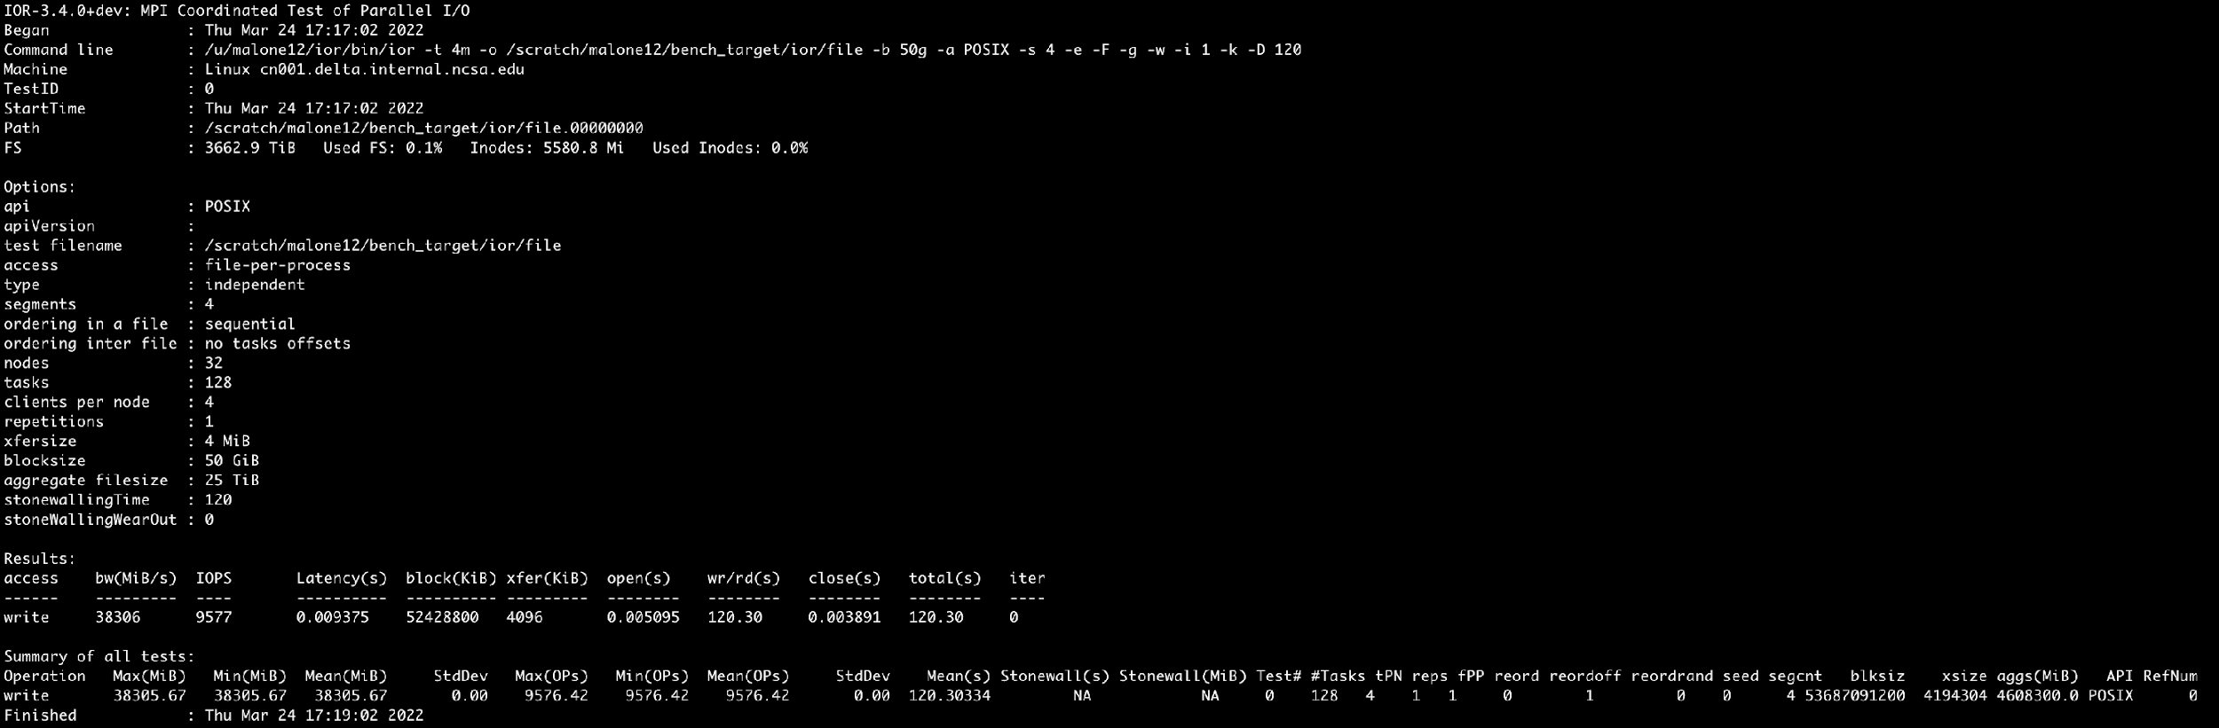
IOR Best Practices/How to Run
That’s a lot of flags ☺ but not as bad as you think, hopefully those definitions helped…here’s an example run:

Slide 31
mdtest HPC Benchmark
mdtest is an MPI-coordinated metadata benchmark test that performs open/stat/close operations on files and directories and then reports the performance.
Uses MPI for communications
Creates multiple files per process
Can specify a shared file or file per process
Can specify that all files go into a single directory or into unique directories
Can run in POSIX and MPIIO modes

Slide 32
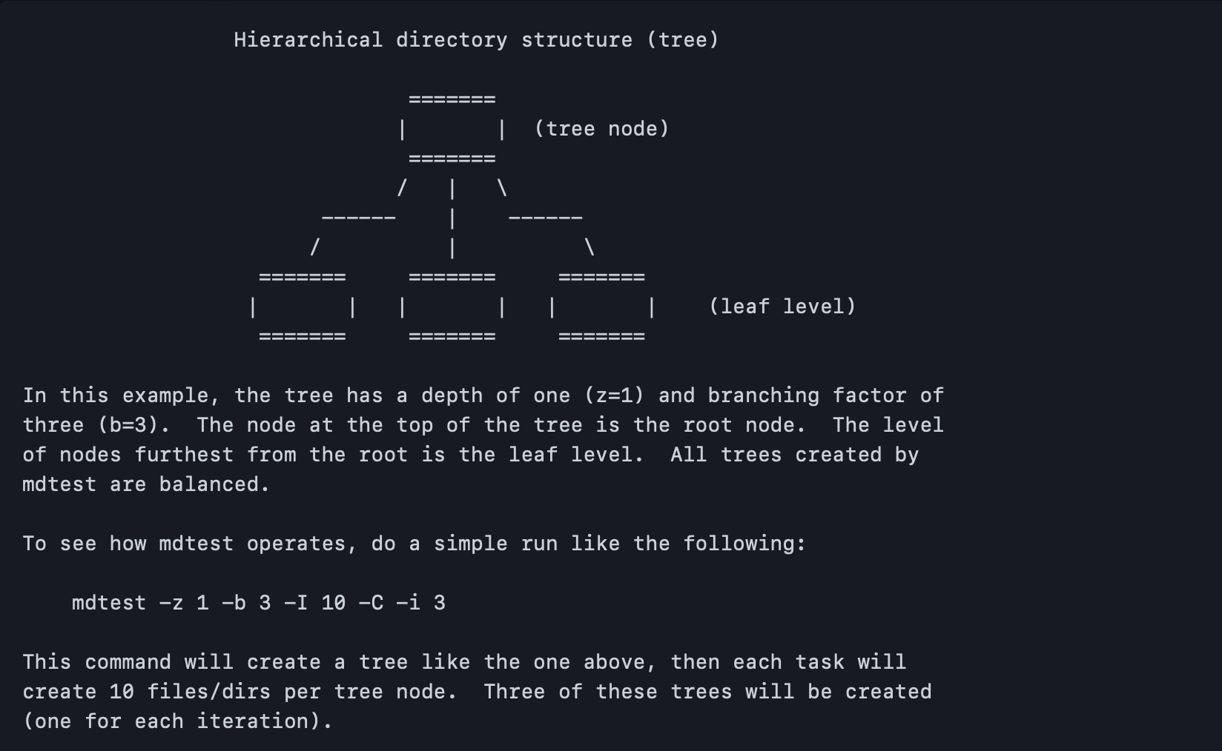
mdtest Best Practices/How to Run
mdtest Diagram of flags to hierarchy (source: LLNL)

Slide 33
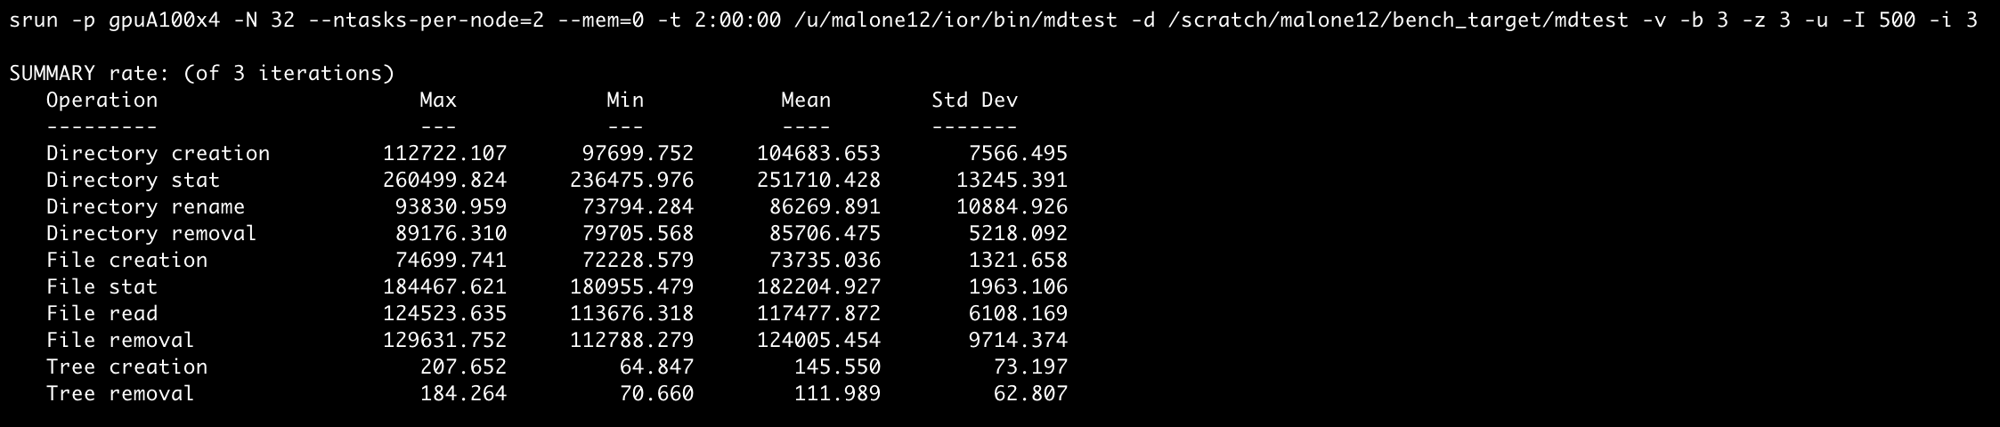
mdtest Best Practices/How to Run
Example run of mdtest using 32 nodes/64 ranks (2 per node)
This run ran 3 iterations, thus showing a Std. Deviation in the right column

Slide 34
Future Trends & Conclusion

Slide 35
Brief Thoughts on Future Storage Trends
Lots of things are shifting in storage on both the hardware and software front (and some linkage in between)
Big tech shifts on the storage side:
SSDs are getting cheaper $/TB as time progresses, trying to catch HDDs and are gaining ground
PCIe generations are moving more quickly than they have in the past (Gen 3 for long time, now Gen 4 and Gen 5; Gen 6 on roadmaps not far out) -- driven by CXL work and hyperscalers
New media form factors and cooling methods being discussed and productized
Storage performance is becoming increasingly important to overall system designs

Slide 36
Brief Thoughts on Future Storage Trends
Changes on the hardware side are also leading to evolutions in options on the software side
New file systems are here/being developed that build on and assume ”modern” all-flash architectures
Re-writing file system solutions from scratch can help lead to totally new capabilities
Growing emphasis on the features of the file systems and access methods
No longer just POSIX
Some want S3, some want CSI drivers, etc.
Need policy engine and migration/manipulation tools
More reporting capability and data isolation features

Slide 37
Brief Thoughts on Future Storage Trends
Increased “regulation” around how long data needs to be retained, how it is handled, and how it needs to be accessed
More classifications and restrictions around data
CUI, HIPAA, etc.
Minimum retention policies
Ability to audit compliance with regard to funding agency policies
Sustainability is also key
Funding for storage usually isn’t plentiful, it isn’t shiny (often)
As datasets get larger the ability of researchers to use use the “external hard drive method” is fading a bit
More data is needing to be managed by fewer and fewer admins/engineers; need solutions that help ease that burden

Slide 38
Conclusions
There is no one right solution for HPC Storage systems
Each solution is highly dependent on your environment
The more time you spend gathering requirements and talking with your stakeholders, the better your design but be mindful not to spend too much time here.
Trade-offs are inevitable, focus on prioritizing basic features
Benchmarking can be a valuable long-term tool
Technology changes frequently, but the basic principles are fairly stable
Reach out to the community, most are more than willing to share experiences

Slide 39
Questions?

